Slide 1
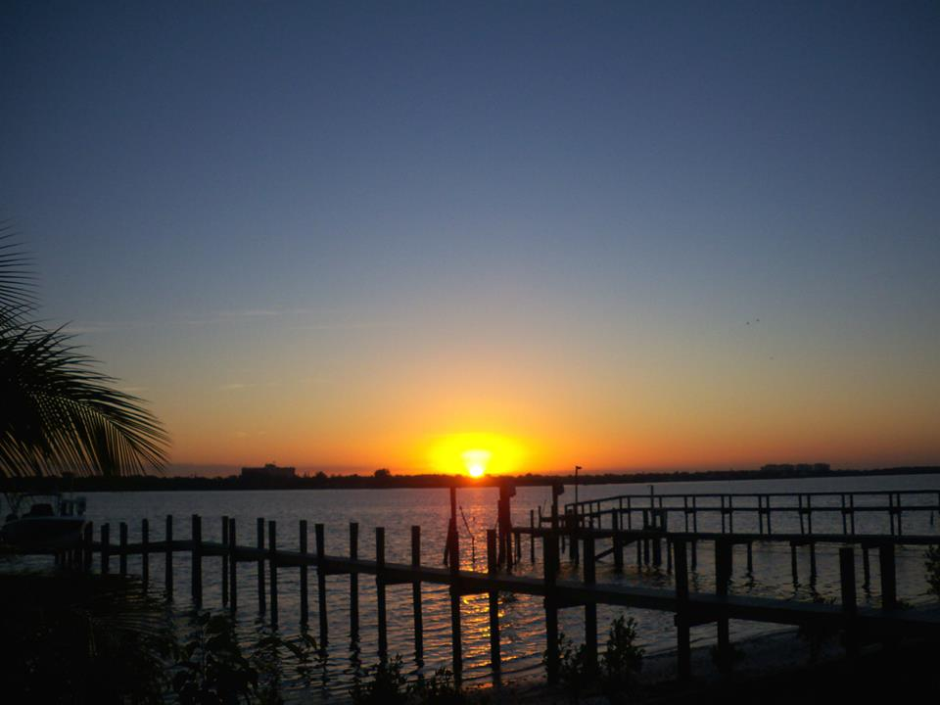
John 14.15-31
photo by Charlie Garrett

Slide 2
John 14.15-31
Physical Touch
Gifts
Quality Time
Affirming Words
Acts of Service

Slide 3
John 14.15-17 NET: “If you love me, you will obey my commandments. Then I will ask the Father, and he will give you another Advocate to be with you forever– the Spirit of truth, whom the world cannot accept, because it does not see him or know him. But you know him, because he resides with you and will be in you.”

Slide 4
Submit Follow/Obey Pursue Mission
Pray in Jesus’ Name Get Prayers Answered
Love

Slide 5
Submit Follow/Obey Pursue Mission
Pray in Jesus’ Name Get Prayers Answered
Holy Spirit Empowerment
John 14.15-16: “If you love me, you will obey my commandments. Then I will ask the Father, and he will give you another Advocate to be with you…
Love

Slide 6
John 14.15-17 NET: “If you love me, you will obey my commandments. Then I will ask the Father, and he will give you another Advocate to be with you forever– the Spirit of truth, whom the world cannot accept, because it does not see him or know him. But you know him, because he resides with you and will be in you.”

Slide 7
John 14.18-20: “I will not abandon you as orphans, I will come to you. In a little while the world will not see me any longer, but you will see me; because I live, you will live too. You will know at that time that I am in my Father and you are in me and I am in you.”

Slide 8
John 14.21-24: “The person who has my commandments and obeys them is the one who loves me. The one who loves me will be loved by my Father, and I will love him and will reveal myself to him.” “Lord," Judas (not Judas Iscariot) said, “what has happened that you are going to reveal yourself to us and not to the world?” Jesus replied, “If anyone loves me, he will obey my word, and my Father will love him, and we will come to him and take up residence with him. The person who does not love me does not obey my words. And the word you hear is not mine, but the Father's who sent me.”

Slide 9
John 14.21-24: “The person who has my commandments and obeys them is the one who loves me. The one who loves me will be loved by my Father, and I will love him and will reveal myself to him.” “Lord," Judas (not Judas Iscariot) said, “what has happened that you are going to reveal yourself to us and not to the world?” Jesus replied, “If anyone loves me, he will obey my word, and my Father will love him, and we will come to him and take up residence with him. The person who does not love me does not obey my words. And the word you hear is not mine, but the Father's who sent me.”

Slide 10
John 14.25-26: “I have spoken these things while staying with you. But the Advocate, the Holy Spirit, whom the Father will send in my name, will teach you everything, and will cause you to remember everything I said to you.”

Slide 11
John 14.27: “Peace I leave with you; my peace I give to you; I do not give it to you as the world does. Do not let your hearts be distressed or lacking in courage.”

Slide 12
“Peace I leave with you; my peace I give to you…”
Isaiah 9.6-7 NET: For a child has been born to us, a son has been given to us. He shoulders responsibility and is called: Extraordinary Strategist, Mighty God, Everlasting Father, Prince of Peace. His dominion will be vast and he will bring immeasurable prosperity. He will rule on David's throne and over David's kingdom, establishing it and strengthening it by promoting justice and fairness, from this time forward and forevermore. The LORD's intense devotion to his people will accomplish this.

Slide 13
“Peace I leave with you; my peace I give to you…”
Romans 5.1-2 NET: Therefore, since we have been declared righteous by faith, we have peace with God through our Lord Jesus Christ, through whom we have also obtained access by faith into this grace in which we stand, and we rejoice in the hope of God's glory.

Slide 14
“Peace I leave with you; my peace I give to you…”
Romans 15.13 NET: Now may the God of hope fill you with all joy and peace as you believe in him, so that you may abound in hope by the power of the Holy Spirit.

Slide 15
“Peace I leave with you; my peace I give to you…”
John 14.1 NET: “Do not let your hearts be distressed. You believe in God; believe also in me.”
Philippian 4.6-7 NET: Do not be anxious about anything. Instead, in every situation, through prayer and petition with thanksgiving, tell your requests to God. And the peace of God that surpasses all understanding will guard your hearts and minds in Christ Jesus.

Slide 16
John 14.27: “Peace I leave with you; my peace I give to you; I do not give it to you as the world does. Do not let your hearts be distressed or lacking in courage.”
Jeremiah 6.13-15 NET: “Prophets and priests alike, all of them practice deceit. They offer only superficial help for the harm my people have suffered. They say, ‘Everything will be all right!’ But everything is not all right! Are they ashamed because they have done such shameful things? No, they are not at all ashamed. They do not even know how to blush! So they will die, just like others have died. They will be brought to ruin when I punish them,” says the LORD.

Slide 17
John 14.27: “Peace I leave with you; my peace I give to you; I do not give it to you as the world does. Do not let your hearts be distressed or lacking in courage.”
Jeremiah 6.16 NET: The LORD said to his people: “You are standing at the crossroads. So consider your path. Ask where the old, reliable paths are. Ask where the path is that leads to blessing and follow it. If you do, you will find rest for your souls.”

Slide 18
John 14.28-29: “You heard me say to you, ‘I am going away and I am coming back to you.’ If you loved me, you would be glad that I am going to the Father, because the Father is greater than I am. I have told you now before it happens, so that when it happens you may believe.”

Slide 19
John 14.30-31: “I will not speak with you much longer, for the ruler of this world is coming. He has no power over me, but I am doing just what the Father commanded me, so that the world may know that I love the Father. Get up, let us go from here.”

Slide 20
Faith Love Obedience Peace

